Slide 1
BANK-CUSTOMERS FINACIAL DATASET VISUALIZATION
-Using dax functions

Slide 2
OVERVIEW OF DATASET:
The dataset contains information related to a bank's marketing campaigns, where the target variable is whether a customer subscribes to a term deposit. It includes demographic, financial, and engagement details of bank customers. The dataset is well-suited for classification tasks and provides rich information for analyzing customer behavior and predicting outcomes of marketing campaigns. There are 39,188 records and 21 attributes. Some columns have missing data, especially in categorical variables like "education" and "default."

Slide 3
ATTRIBUTES
Demographic Information:
age: Age of the customer (integer).
job: Type of job
marital: Marital status education: Level of education
Financial Information:
default: Whether the customer has credit in default
housing: Whether the customer has a housing loan .
loan: Whether the customer has a personal loan
Campaign Contact Information:
contact: Contact communication type
month: Month of last contact.
day_of_week: Day of the week of last contact (categorical).

Slide 4
Engagement Metrics:
duration: Last contact duration in seconds
campaign: Number of contacts performed during this campaign for this client
pdays: Number of days since the client was last contacted previous: Number of contacts performed before this campaign
poutcome: Outcome of the previous campaign
Economic Indicators:
emp.var.rate: Employment variation rate
cons.price.idx: Consumer price index
cons.conf.idx: Consumer confidence index
euribor3m: Euribor 3-month rate
nr.employed: Number of employees in the market
Target Variable:
y: Whether the customer subscribed to a term deposit

Slide 5
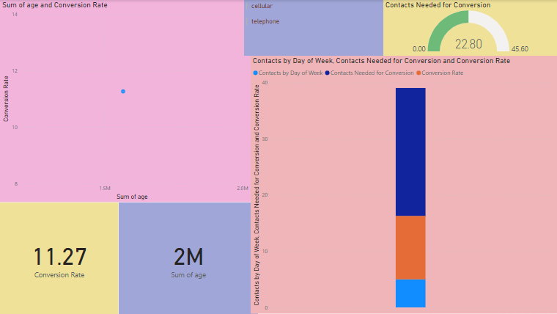
REPORT :1

Slide 6
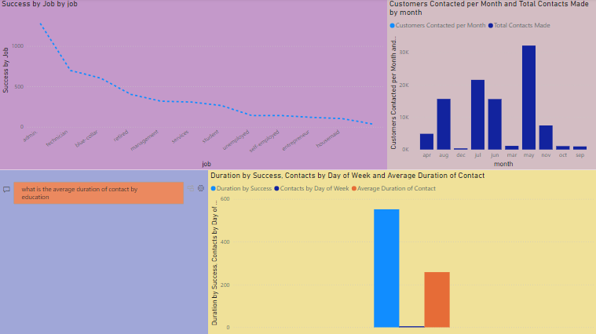
REPORT : 2

Slide 7
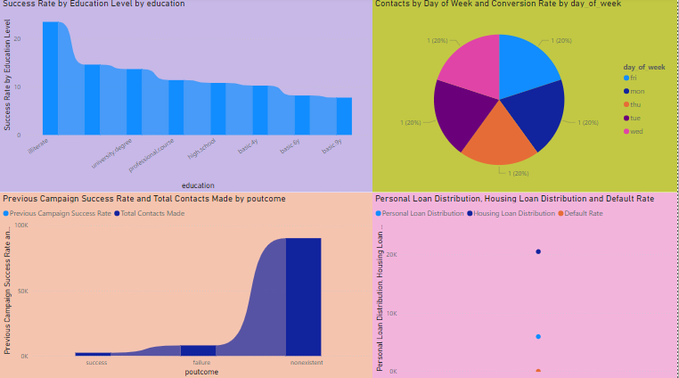
REPORT : 3

Slide 8
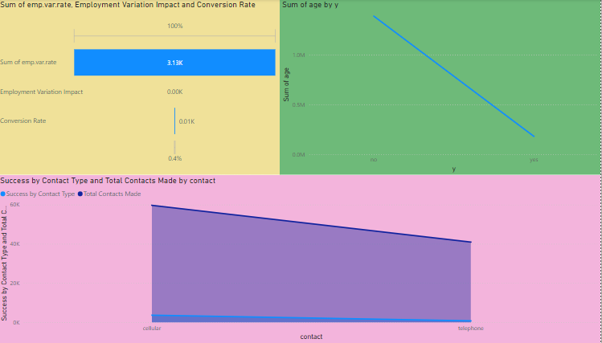
REPORT : 4

Slide 9
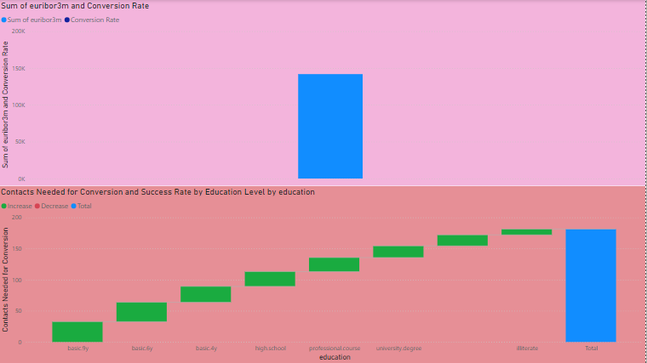
REPORT : 5

Slide 10

-ALURI HARITHA ARUN

